Slide 1
Workshop 1
Basic Hardware & Arduino

Slide 2
Introduction to Basic Hardware

Slide 3
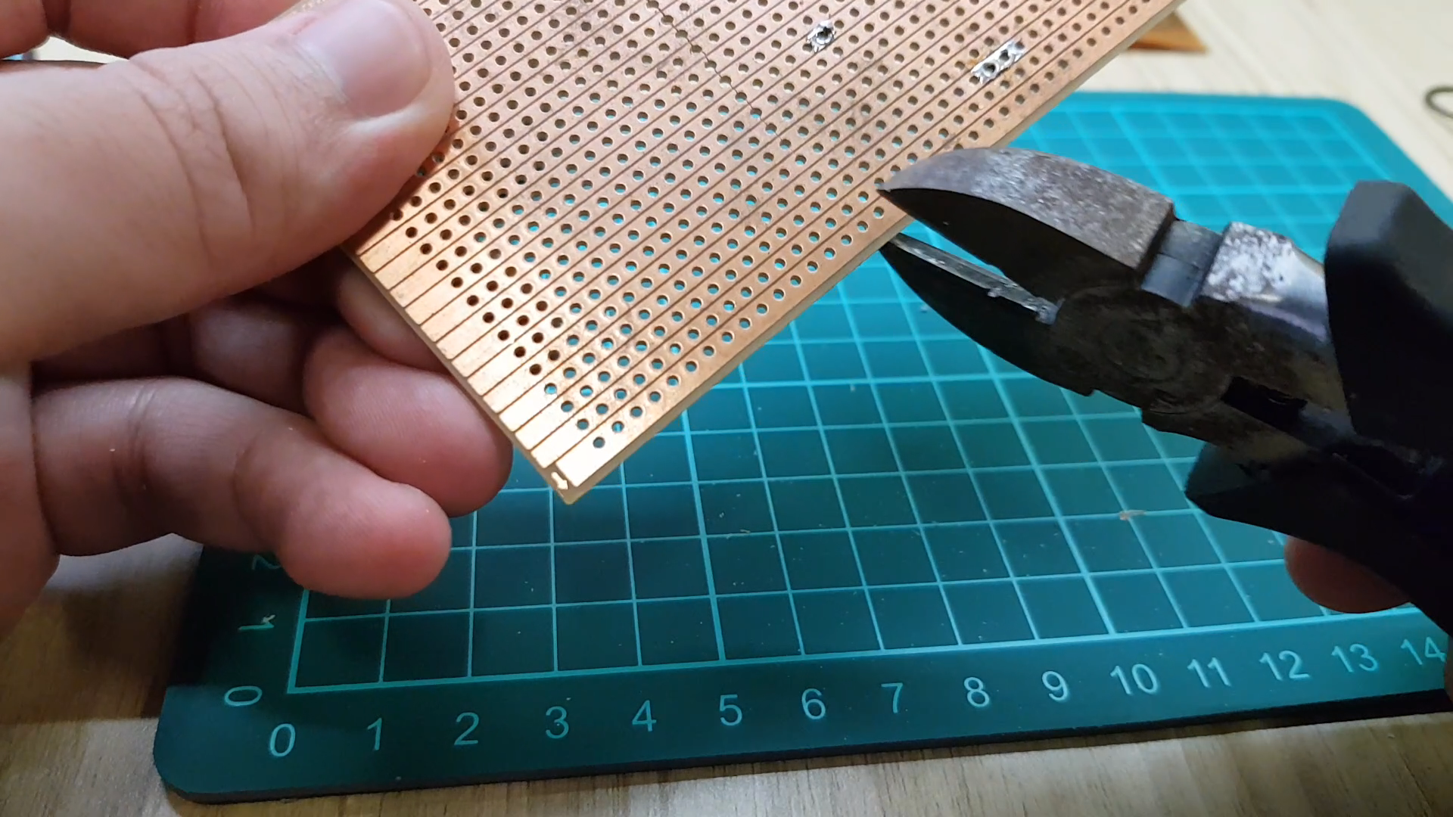
Wire Cutter (Fun Fact)
- Wire Cutting
- Removing excess leads from soldered components (obvious)
- Cutting Prototyping Boards
Notes:
Talk about Rapid Prototyping. (Arduino and also use of single core wires)

Slide 4
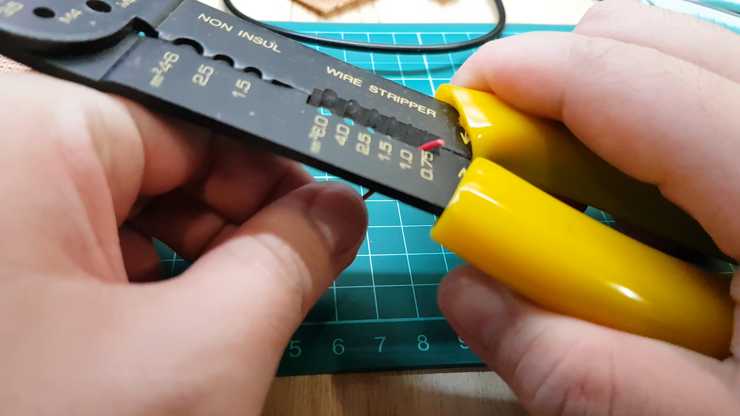
Wire Stripper (Fun Fact)
- Ease of stripping wires.
- Usually come with wire cutter
- Some wire cutters are “automatic”
Notes:
Talk about Rapid Prototyping. (Arduino and also use of single core wires)

Slide 5
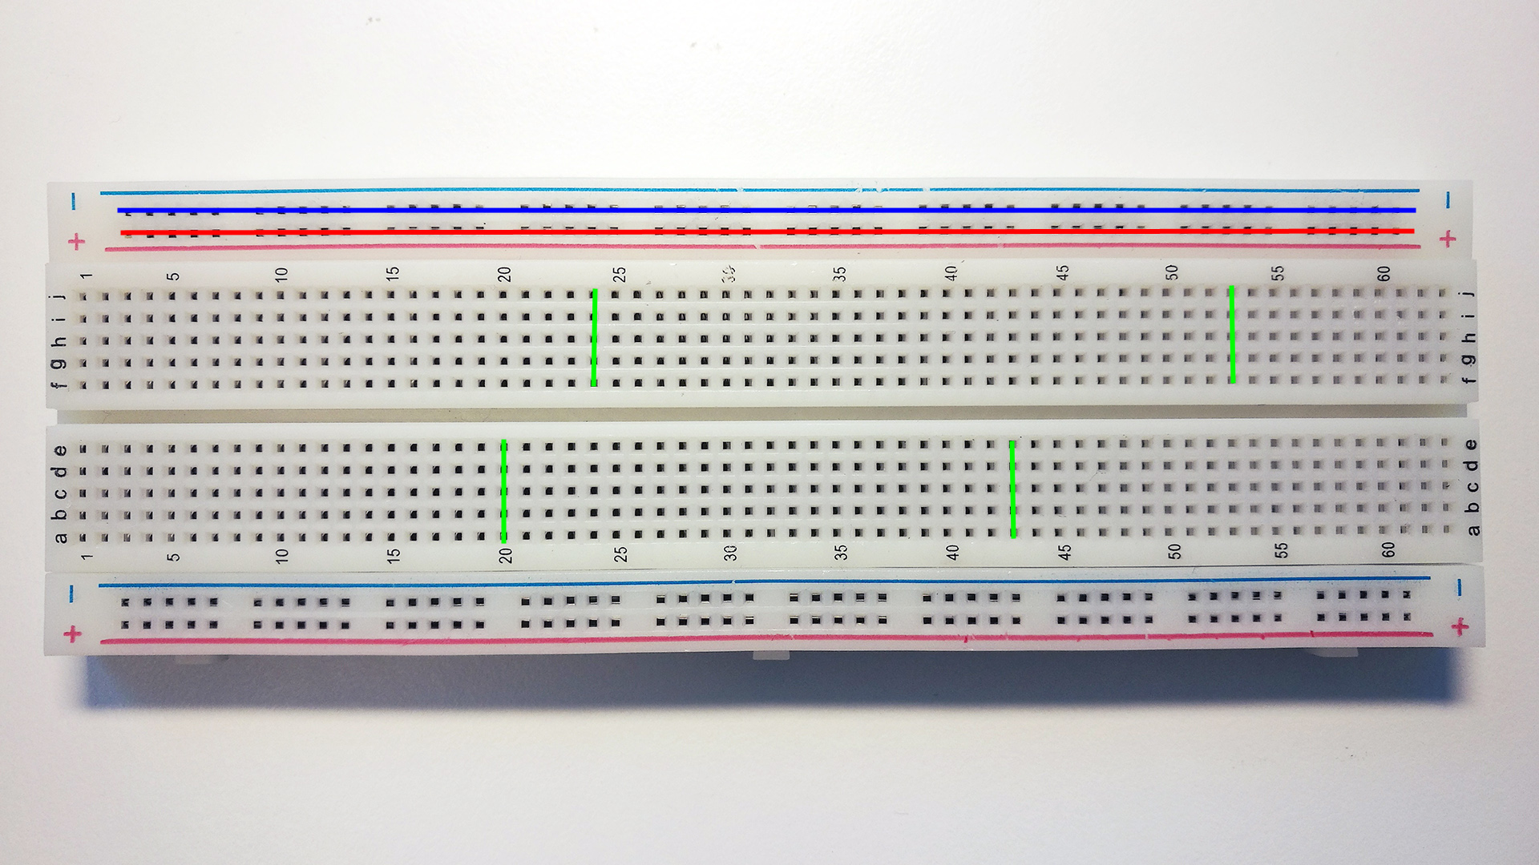
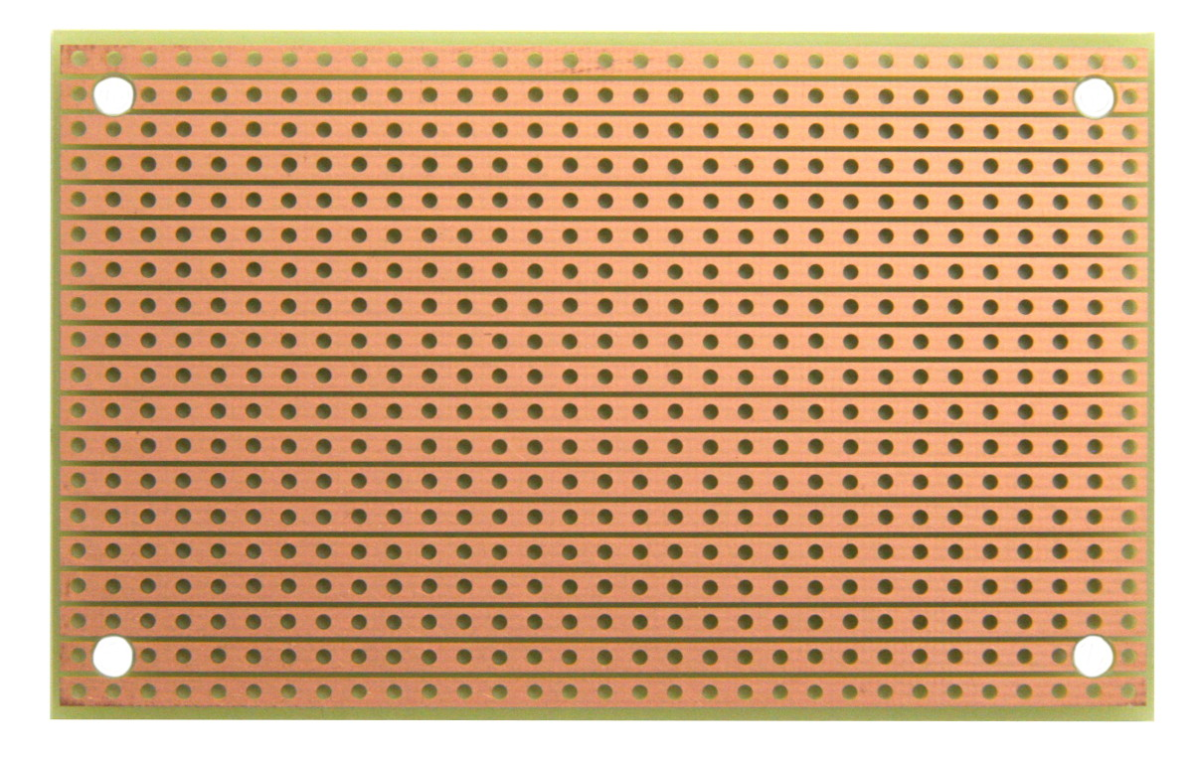
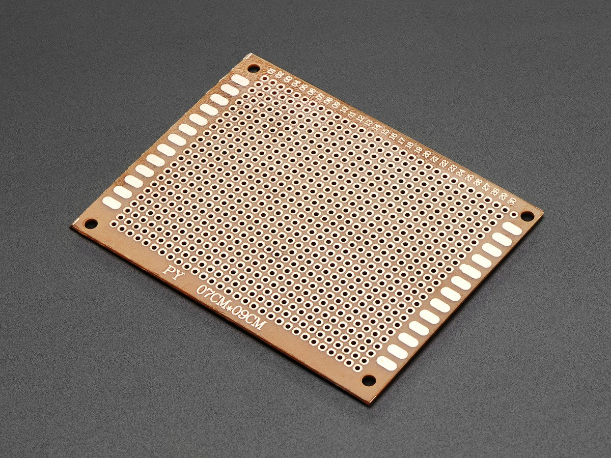
Prototyping Board (Types)
Breadboard
Stripboard
Perfboard

Slide 6
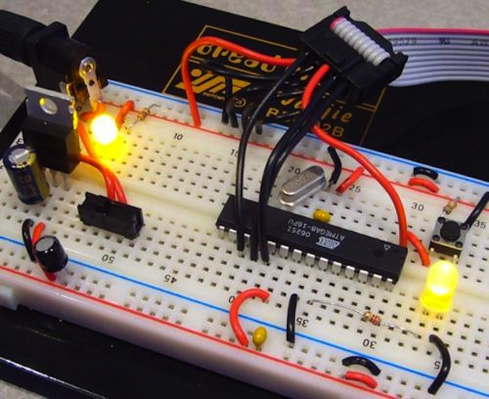
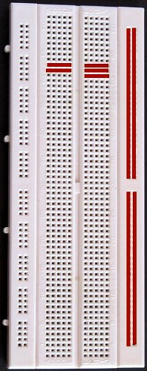
Prototyping Board (Breadboard)
Benefits:
- Rapid Prototyping
- No Soldering
Limitations:
- Bulky
- Temporary Prototype
Notes:
Talk about Rapid Prototyping. (Arduino and also use of single core wires)

Slide 7
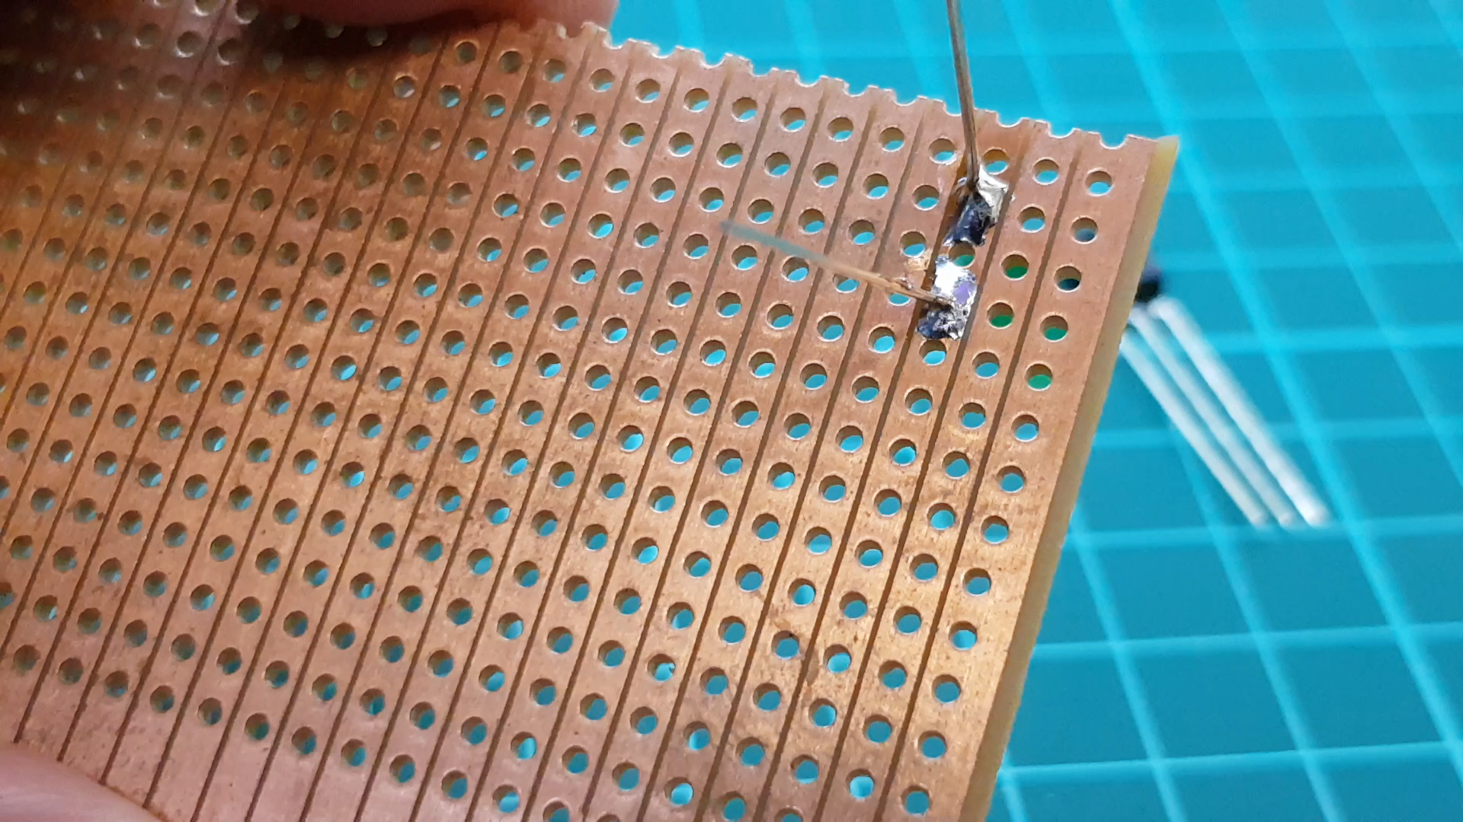
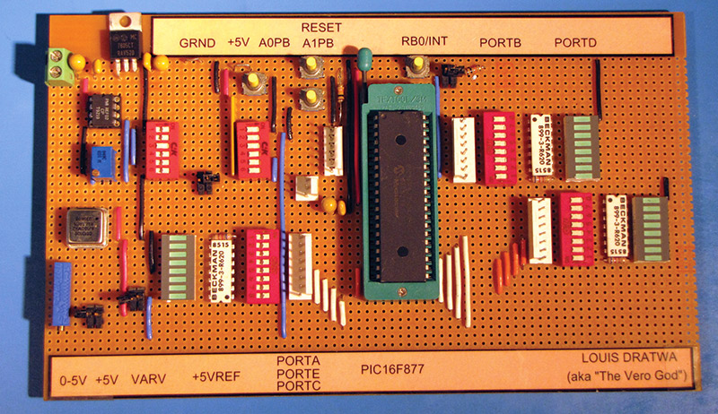
Prototyping Board (Stripboard)
Benefits:
- More Permanent Prototype
- Neat
Limitations:
- Soldering Needed
- Hand Drill Needed to break unwanted but built-in connections
- Some irreversible actions

Slide 8
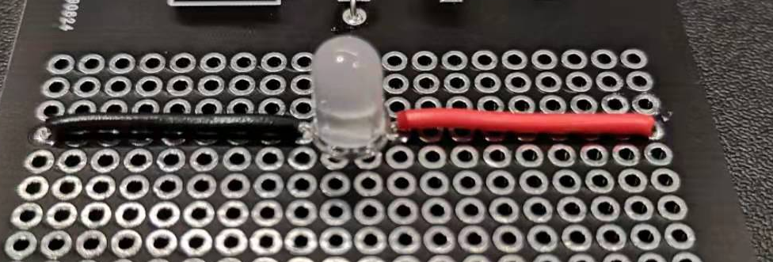
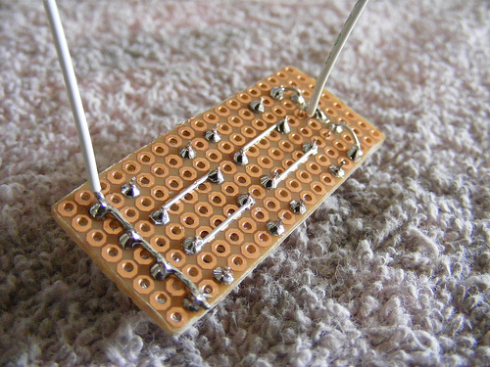
Prototyping Board (Perfboard)
Benefits:
- More Permanent Prototype
- Neat
- Extremely flexible
Limitations:
- Soldering Needed
- Need more wires than stripboard

Slide 9
We will provide you these 3 types of boards
Breadboard
Stripboard
Perfboard

Slide 10
Soldering

Slide 11
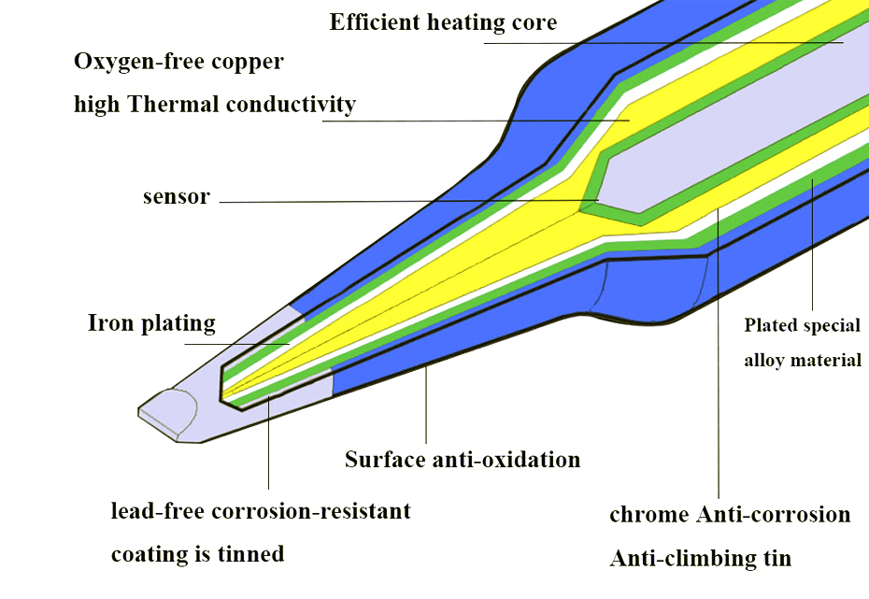
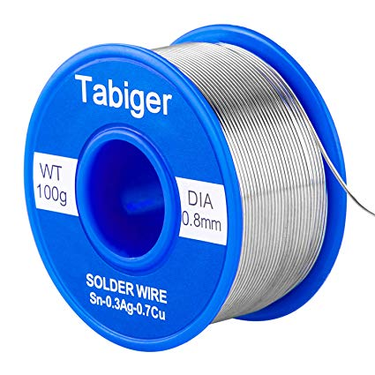
Soldering Iron (Construction)
Apply your solder wire (solder tin) on the iron tip!

Slide 12
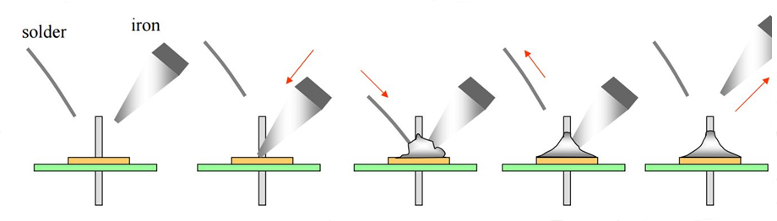
Soldering Techniques- sequence
Count to 5 second, then release soldering iron

Slide 13
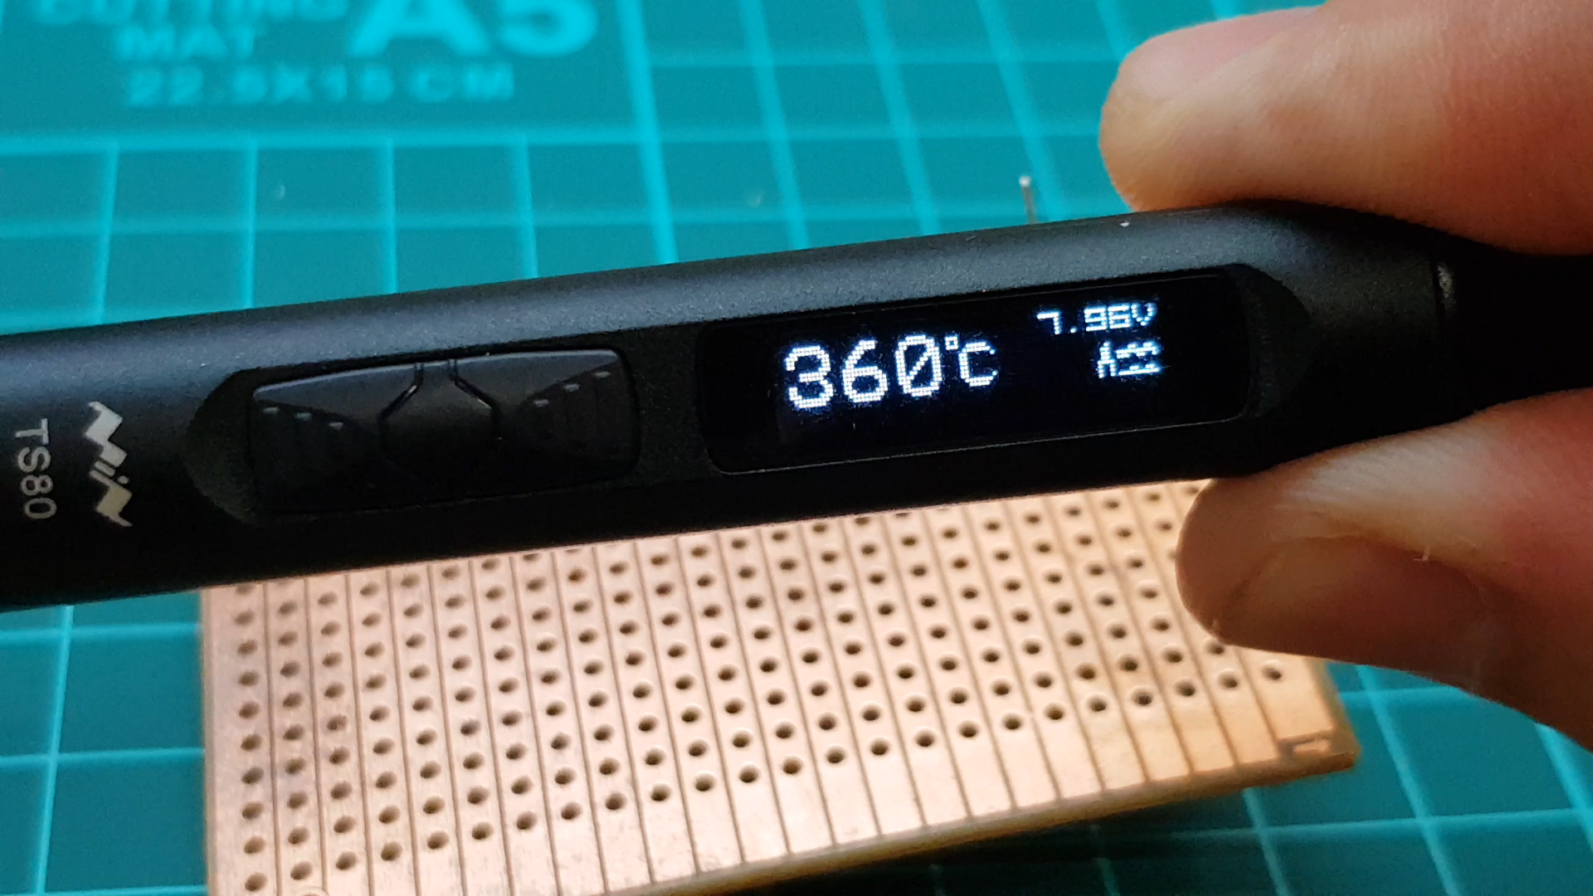
Soldering Techniques

Slide 14

Soldering Techniques – Stability
Make sure your prototype board is secured so that it does not move while being soldered!
Use these to secure the prototype board:
- Tape
- Blue tack
- Bent component leg
- Your friend’s hand (careful!!!)

Slide 15
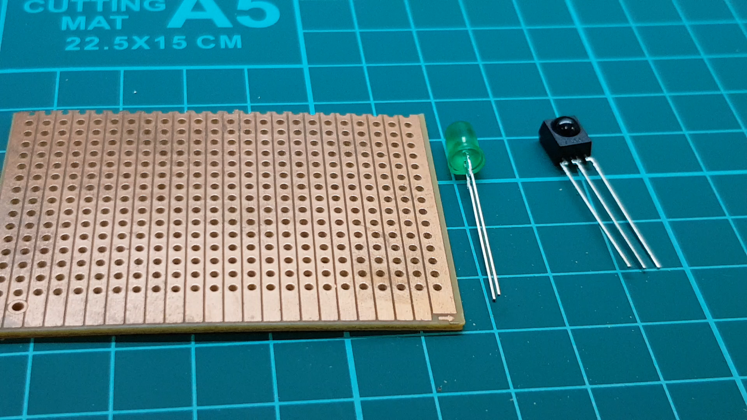
Soldering Techniques - Stability

Slide 16
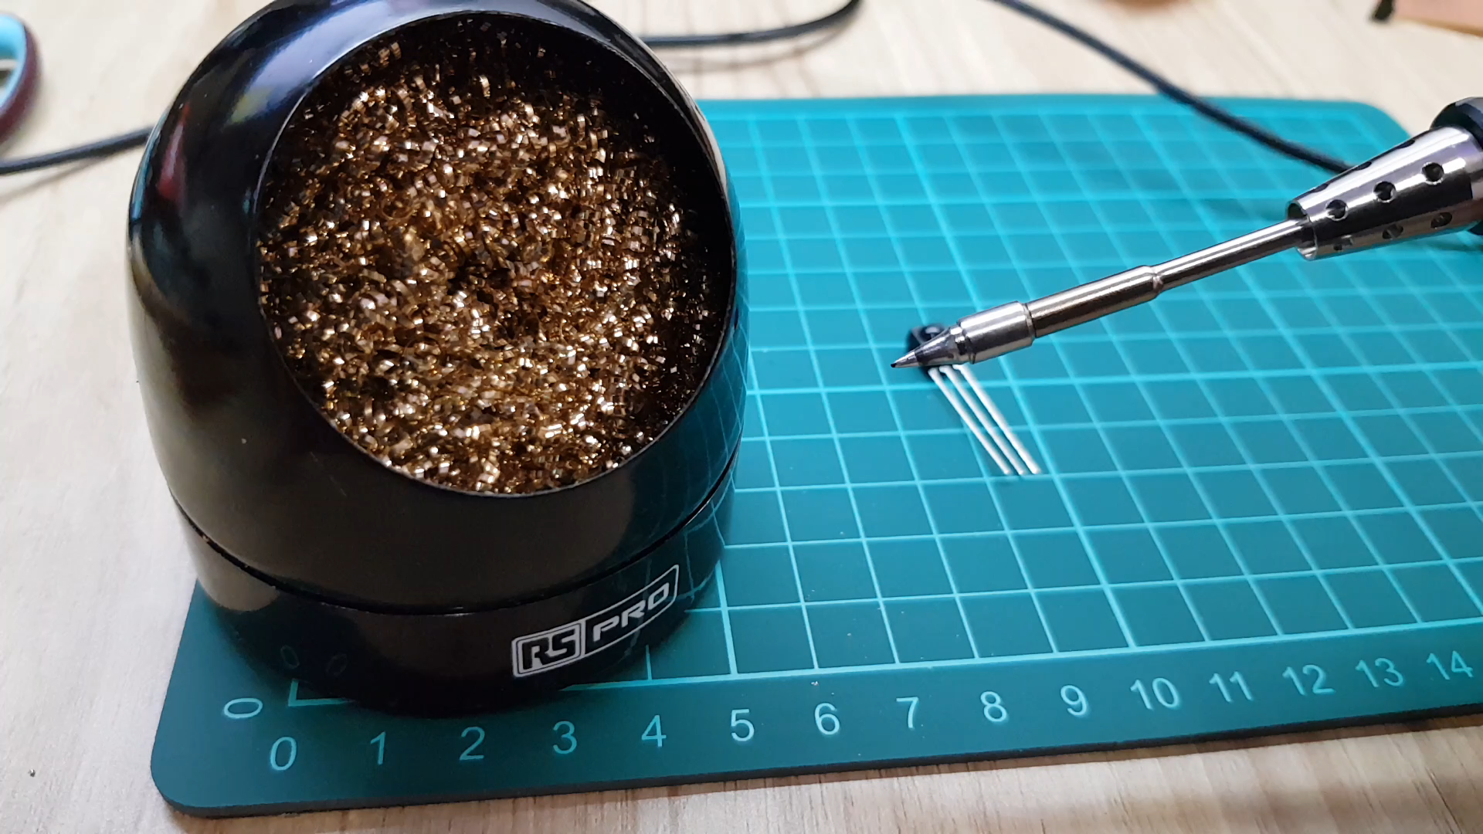
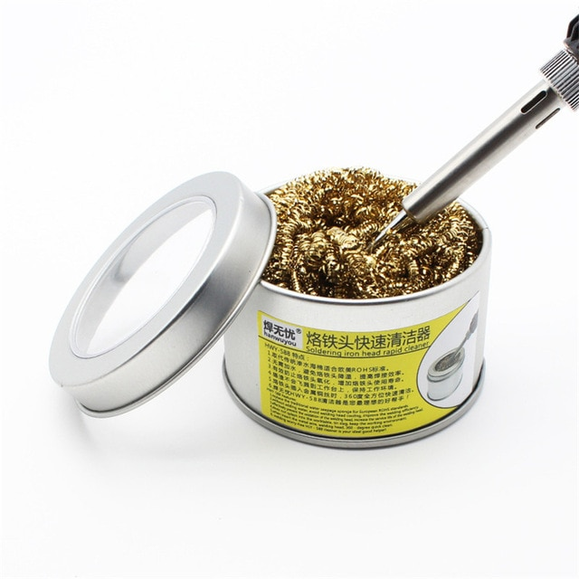
Soldering Iron (How to Clean Your Iron Tip)
Wire Mesh
For better soldering result!
Notes:
Talk about using newspaper

Slide 17
Desoldering

Slide 18
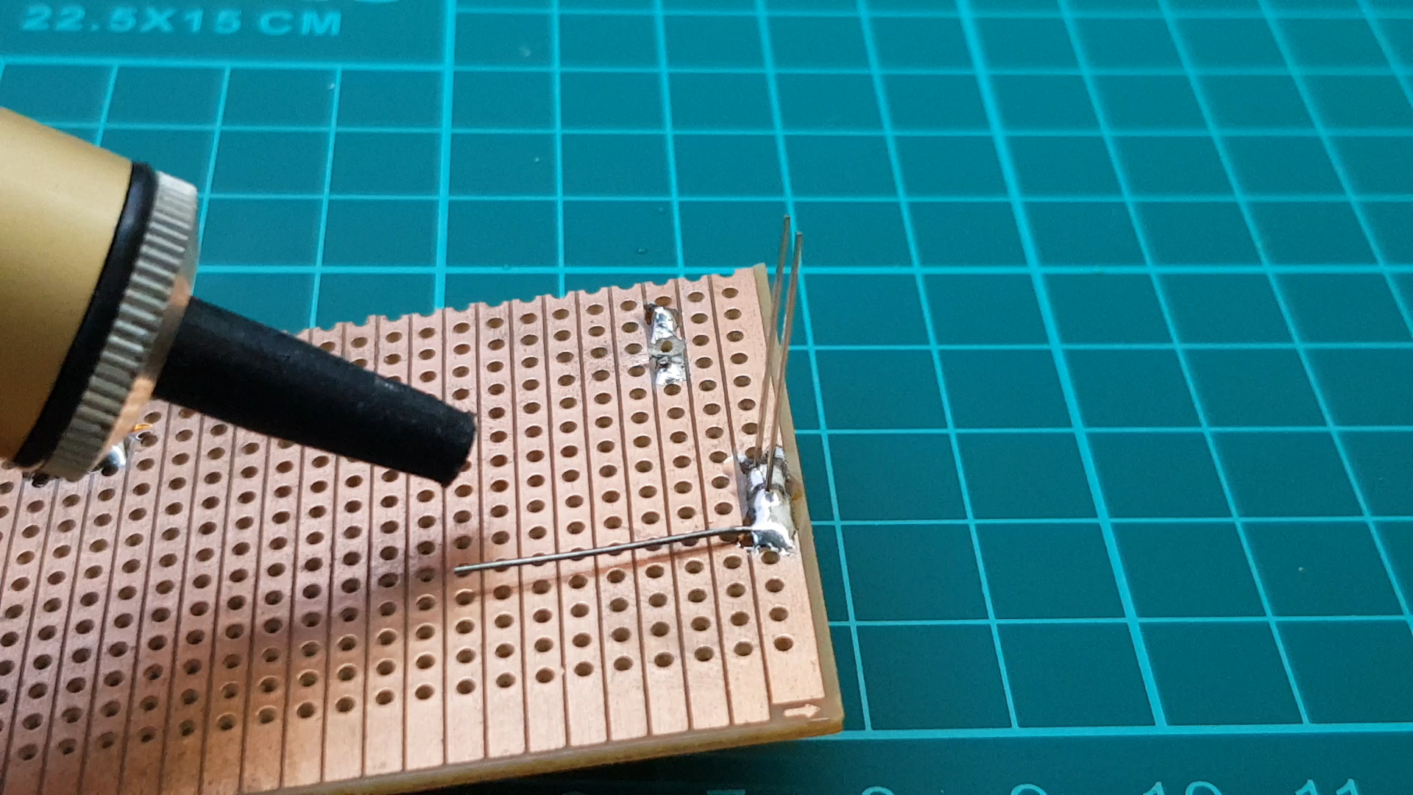
Desoldering Techniques (Hand Pump)

Slide 19
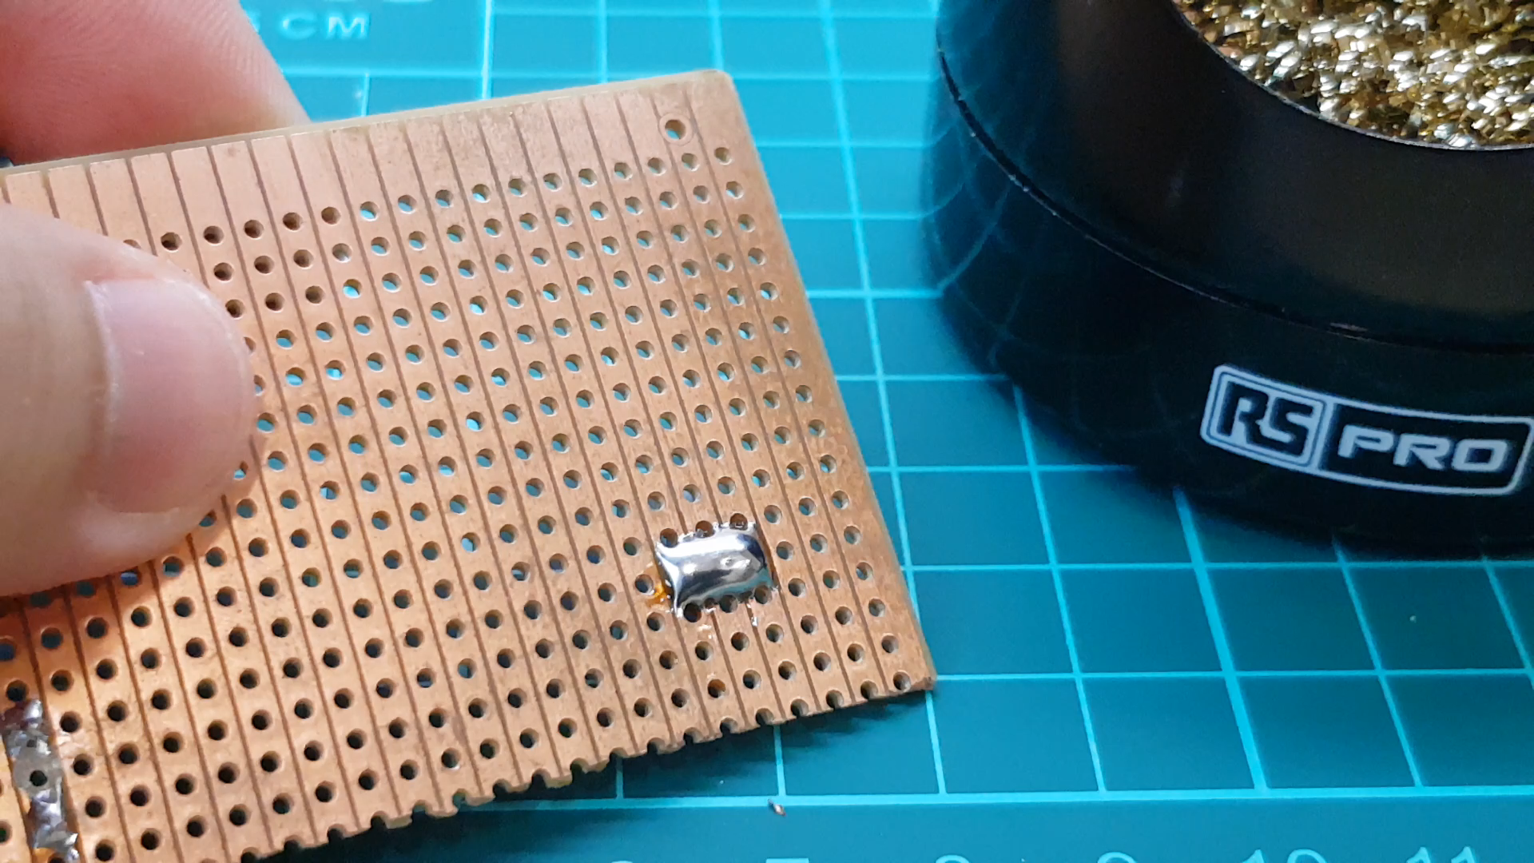
Desoldering Techniques (Solder Bridge)

Slide 20
Troubleshooting Circuit

Slide 21
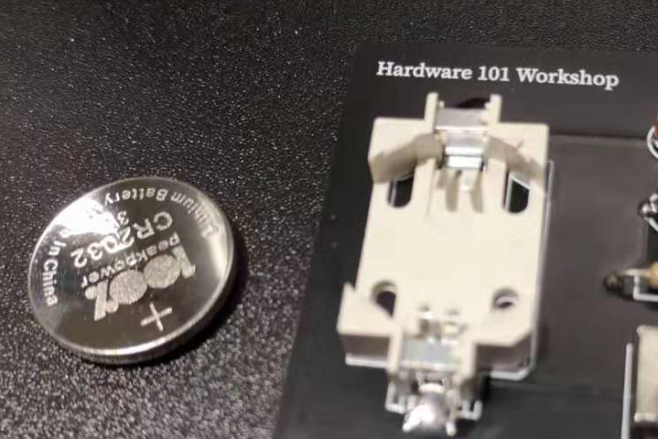
Circuit Troubleshooting - Mentality
Step 1: disconnect the power source

Slide 22

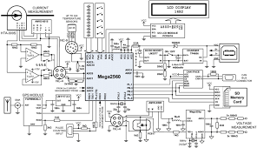
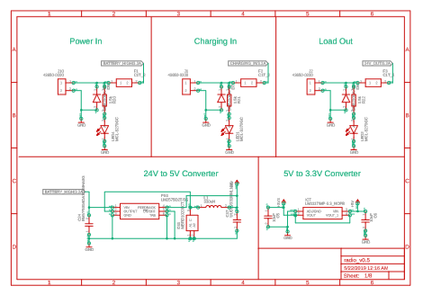
Circuit Troubleshooting - Mentality
Step 2: narrow down to a “functional part” of circuit
X

Slide 23
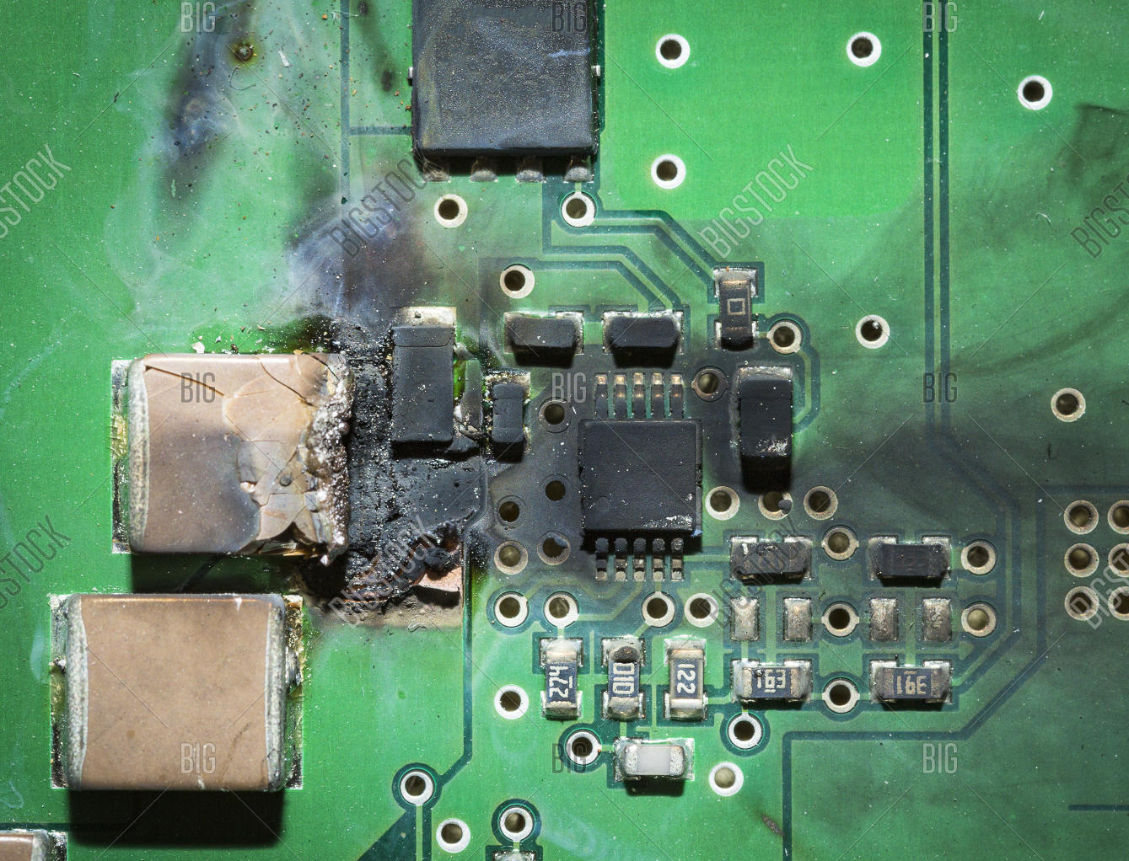
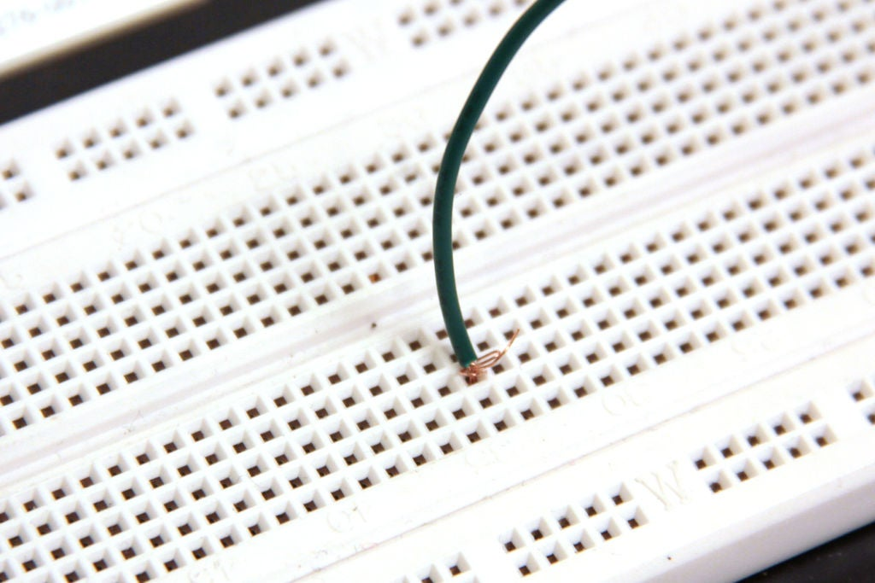
Circuit Troubleshooting - Mentality
Step 3: look for visual clue:
Burn
Dangling/loose wires
(Open Circuit)

Slide 24
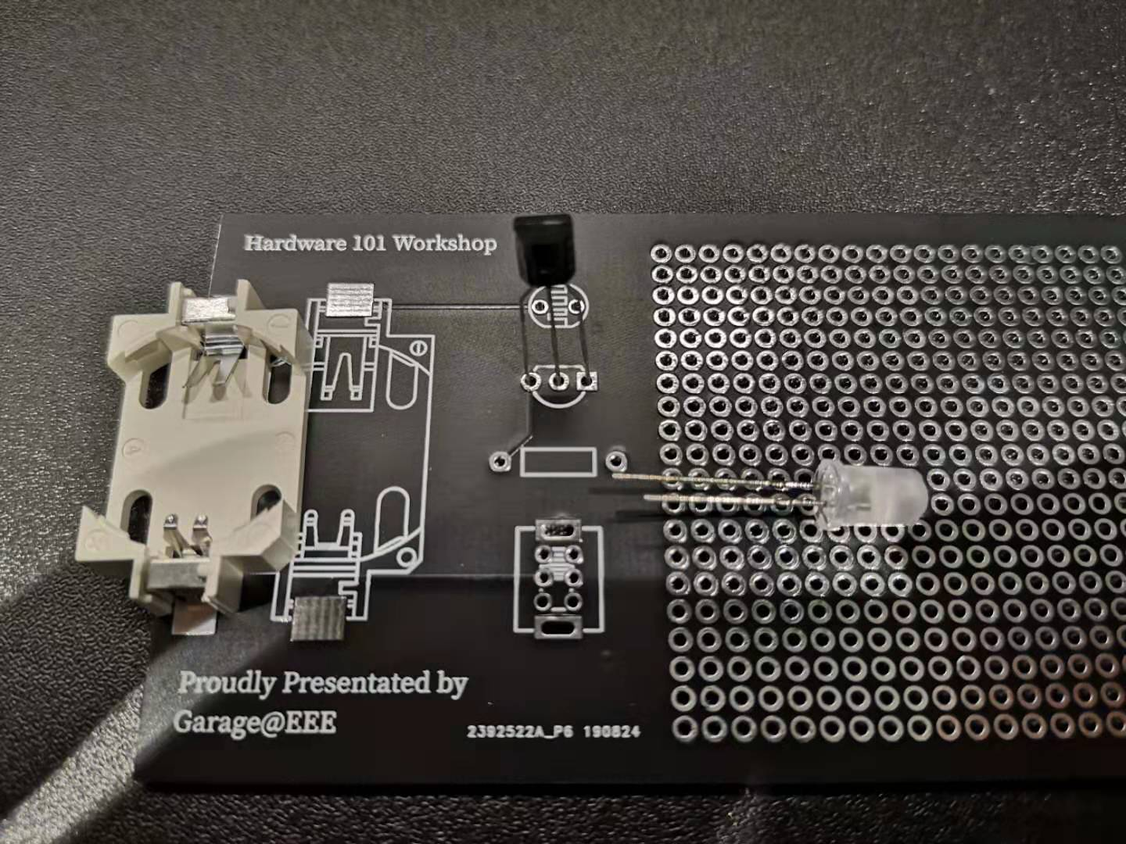
Circuit Troubleshooting - Mentality
Step 3: look for visual clue:
-Wrong orientation?

Slide 25

Circuit Troubleshooting - Multimeter
Continuity test: check whether wire / connection is good

Slide 26
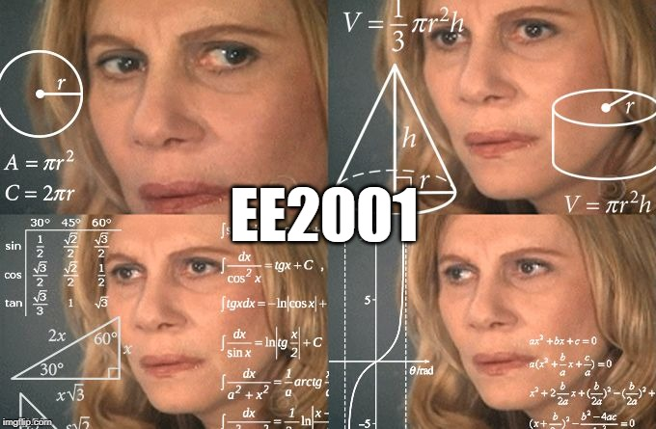
Circuit Troubleshooting - Mentality
Step 5: Circuit Analysis
Is the voltage there or is the current there? What is the expected value? Is the value correct?

Slide 27
Introduction to Arduino

Slide 28

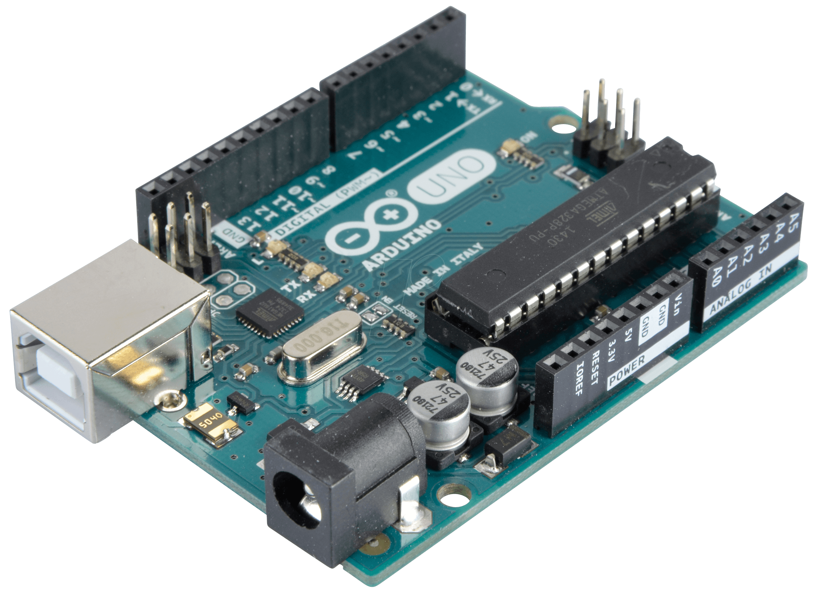
What is ?
World’s leading open-source hardware and software ecosystem
Originally started as a research project at the Interaction Design Institute of Ivrea, Italy
Tool for IoT product development, project prototyping and for STEM education.
ARDUINO UNO

Slide 29

What is ?
Software
Programs are written in the Arduino Integrated Development Environment (IDE)
Known as “Sketches”
Files (.ino) are uploaded to the Arduino board via USB cable

Slide 30
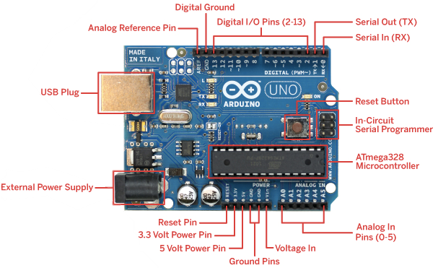

Slide 31
Assumption: You know basic concept of programming, such as variables, functions, if else, for loop, while loop, etc.

Slide 32
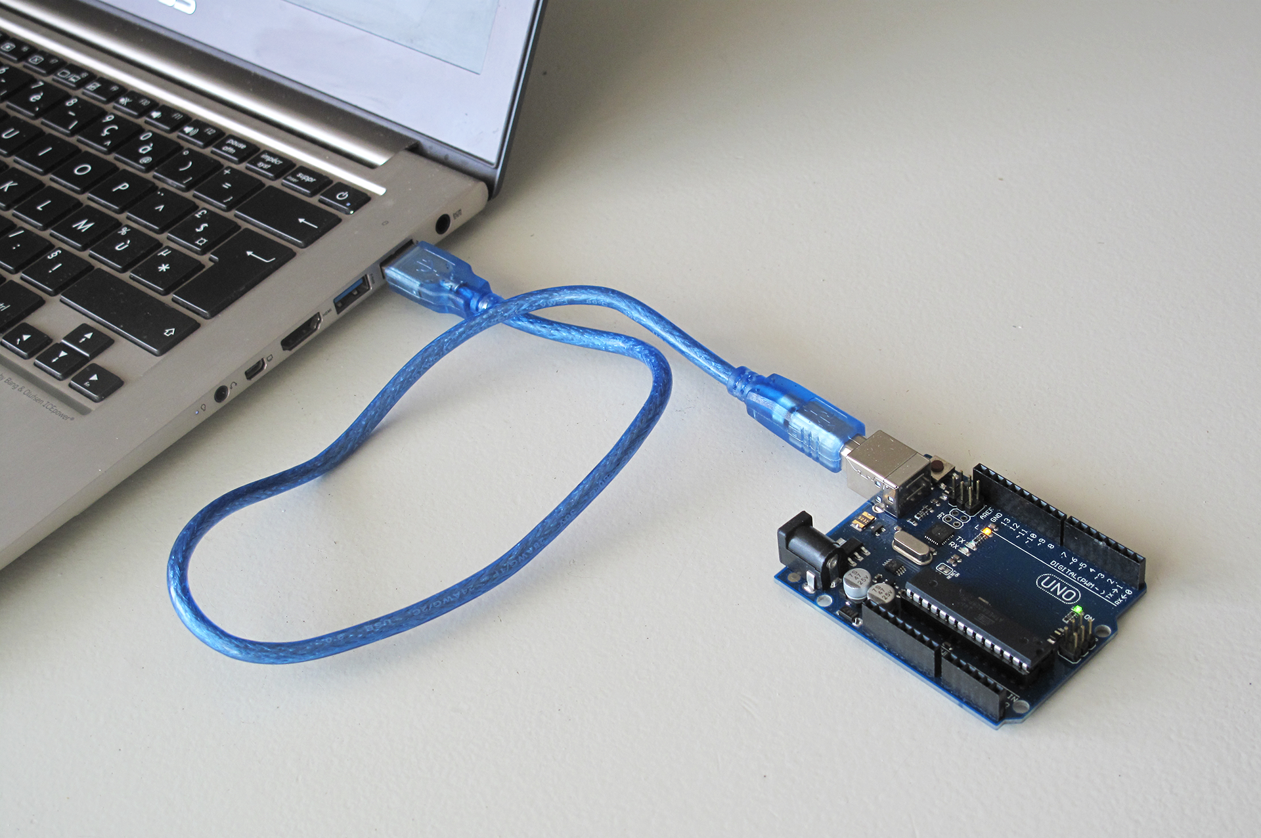
Getting Started!
Connect the Arduino board to your computer

Slide 33
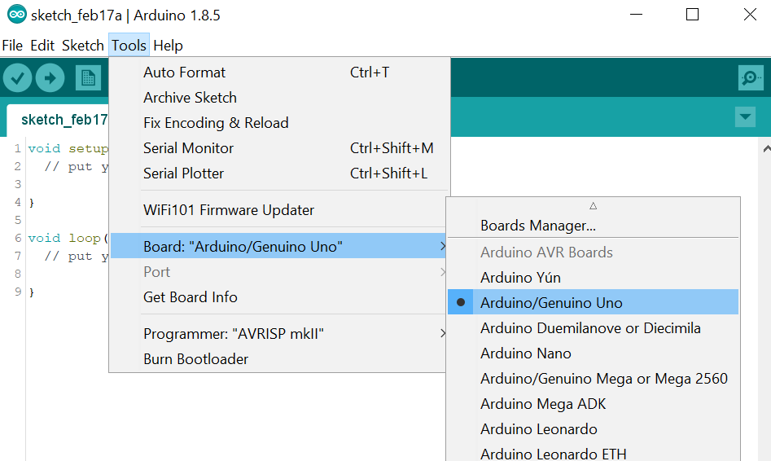
Getting Started!
Ensure that “Arduino/Genuino Uno” is selected as the board: Tools > Board > Arduino/Genuino Uno

Slide 34
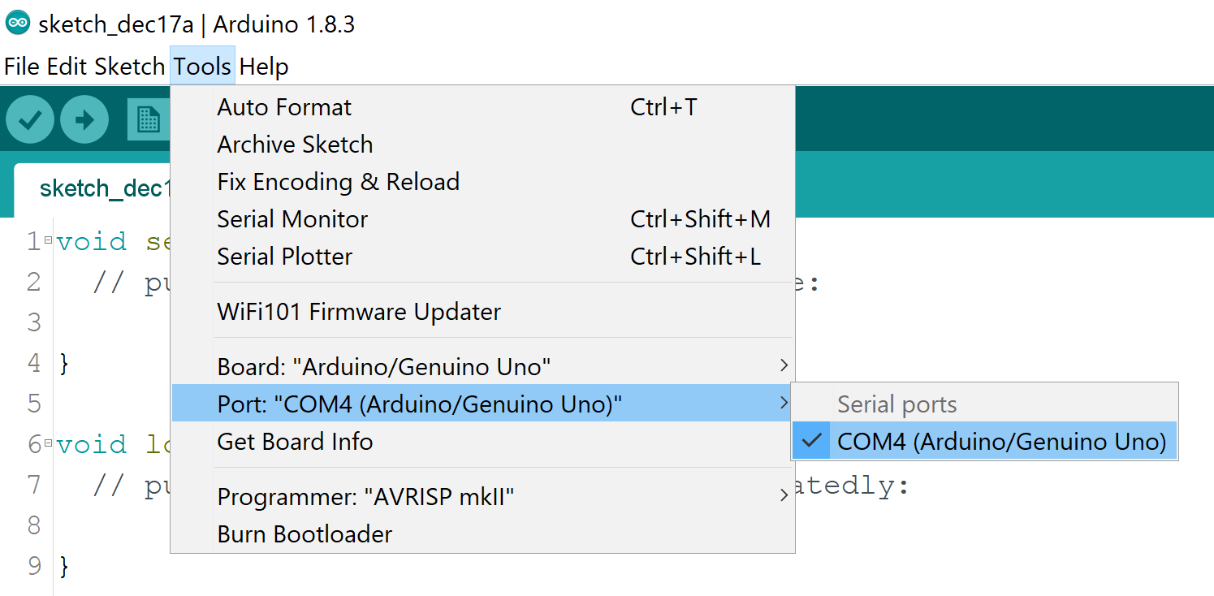
Getting Started!
Ensure that “Arduino/Genuino Uno” is selected as the board: Tools > Port > COM[X] (Arduino/Genuino Uno)

Slide 35
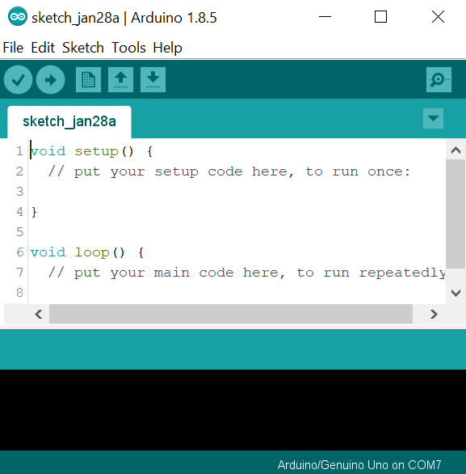
Getting Started!
Verify
Compile the program and check for errors
Upload
Upload program to the Arduino Board
void loop()
Segment where the actual program is used to actively control the Arduino Board
void setup()
Segment where variables, pinModes are declared to initialise the Arduino Board and the program
Will run once after each power up or reset of Arduino Board
Board Information

Slide 36
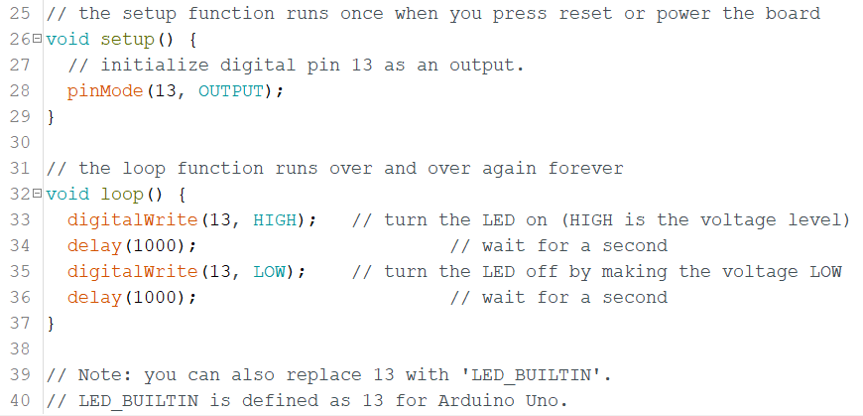
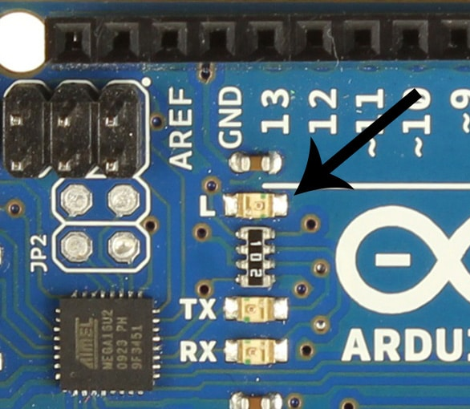
Blinking LED
The code is available at
tinyurl.com/escendo2020
Objective: To blink the onboard LED.

Slide 37
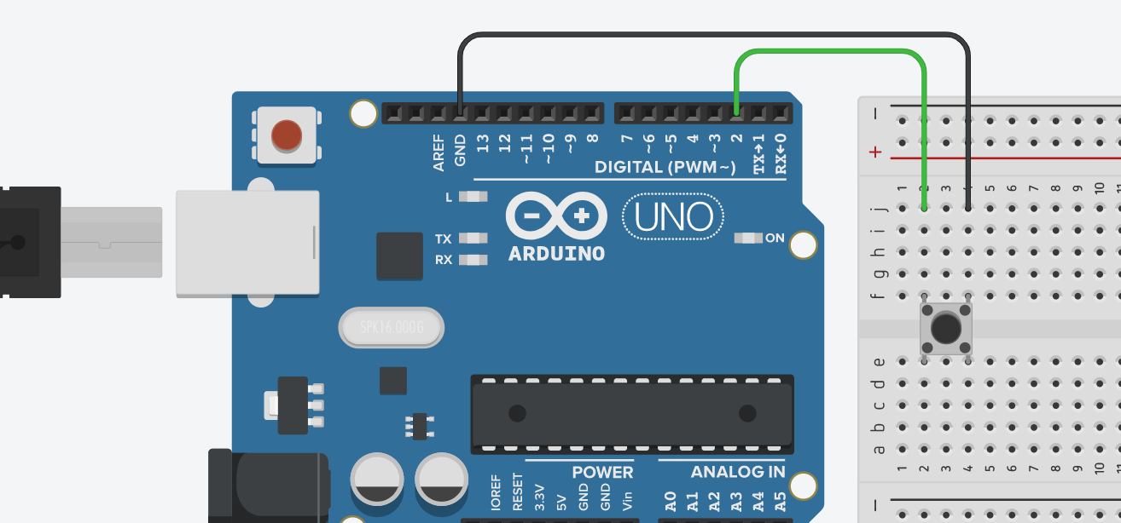
Reading from a Button
Objective: To detect whether a button is pressed.
Wire up your button like so:

Slide 38
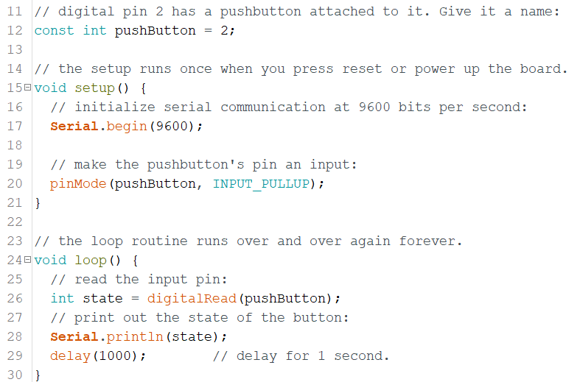
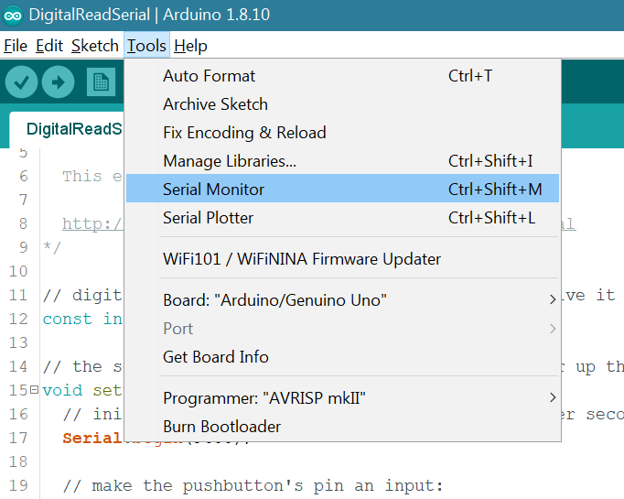
Reading from a Button
The code is available at
tinyurl.com/escendo2020
Objective: To detect whether a button is pressed.

Slide 39
This feature is very useful in debugging (e.g. print value of variables, sensor reading, etc.). You can also print texts, e.g. Serial.print(“Hello! I am:”); Serial.println(my_name); The ‘ln’ means going to a new line after printing.
Serial Monitor

Slide 40
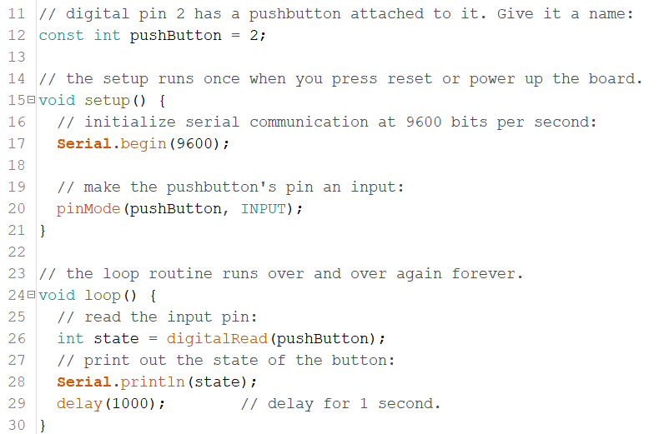
Challenge - Reading from a Button
Try modifying the code so that the button controls whether the onboard LED is on!

Slide 41

Coding for a specific task can get daunting or tedious! Libraries to the rescue! Basically, we are using codes that others have written and shared, so we don’t have to code from scratch to do a specific task.
Libraries

Slide 42
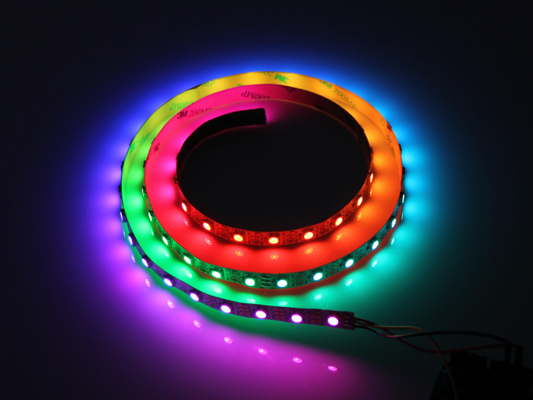
Example: Controlling an LED strip. This is very challenging to code from zero! (need to know LED hardware specification, AVR-C, assembly, direct register access, etc.) Using libraries, the complexity is down to just several lines of codes. We’ll use a neat library called FastLED.
Libraries

Slide 43
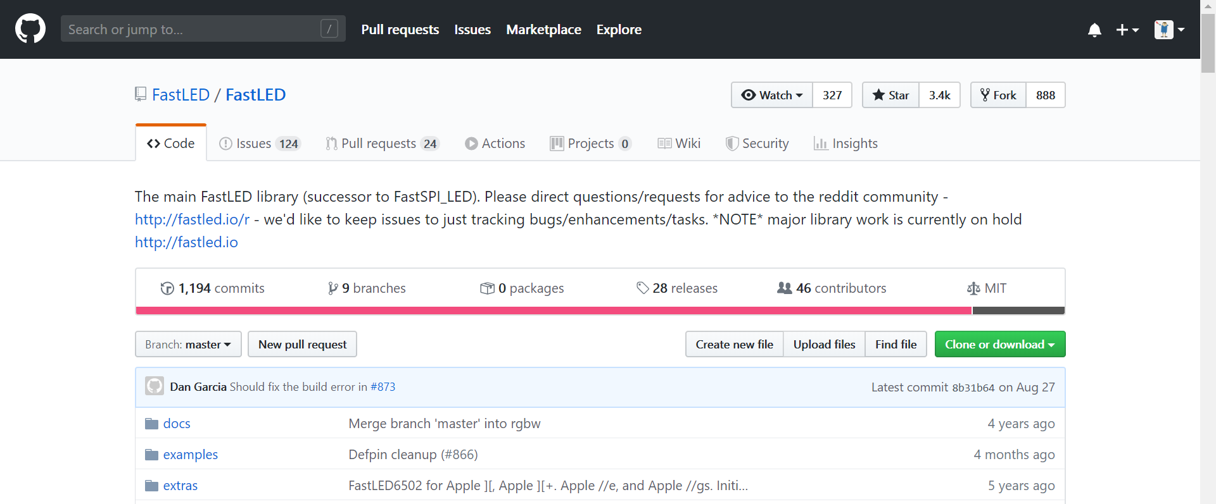
Using Libraries: LED Strip
Go to https://github.com/FastLED/FastLED
Click ‘Clone or download’
Click ‘Download ZIP’
DO NOT
unzip the file!

Slide 44
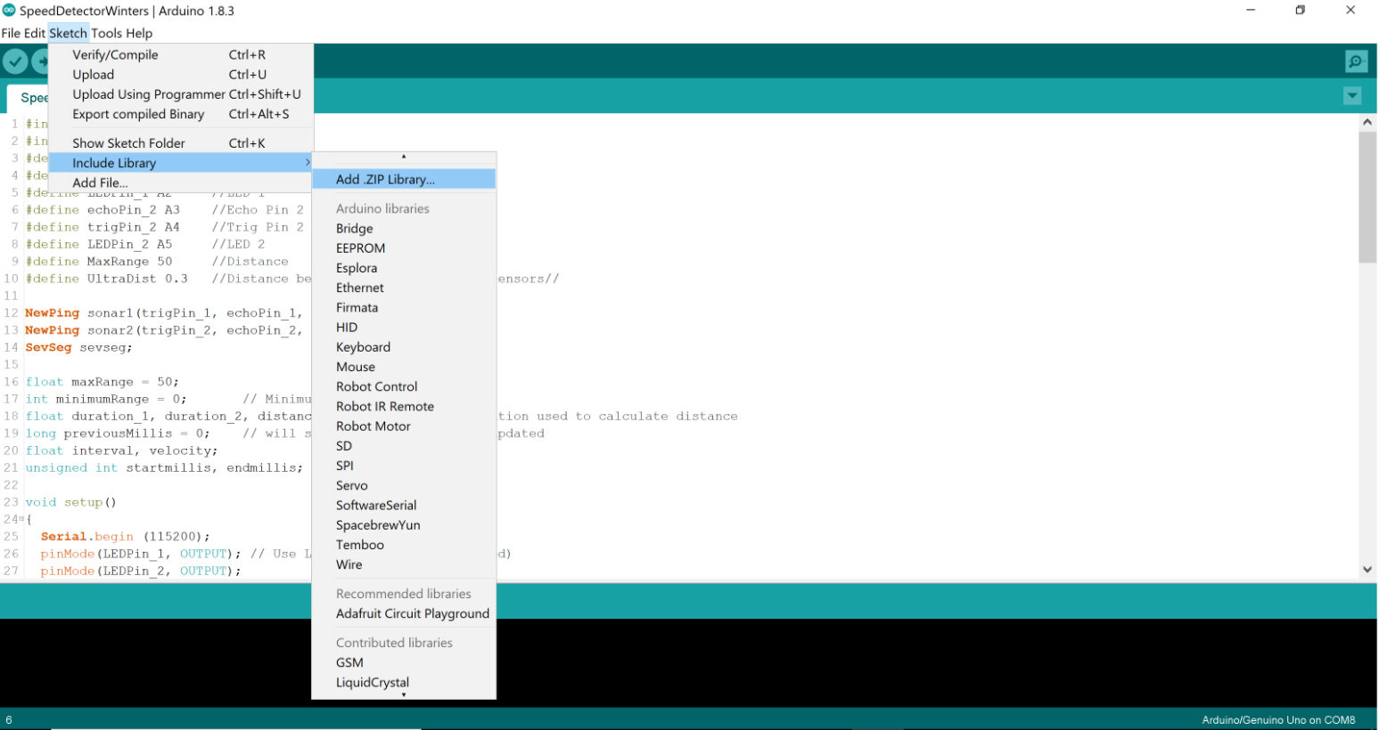
Adding FastLED Library
To add the library into the Arduino IDE:
Sketch > Include Library > Add ZIP Library
Choose the zip file you downloaded

Slide 45
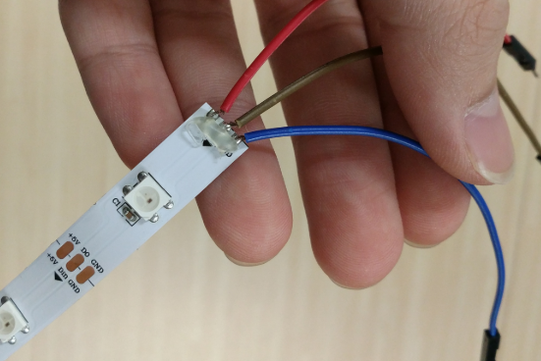
LED Strip
Objective: to control an LED strip.
Connections:
5V
Data (Pin 3)
GND

Slide 46
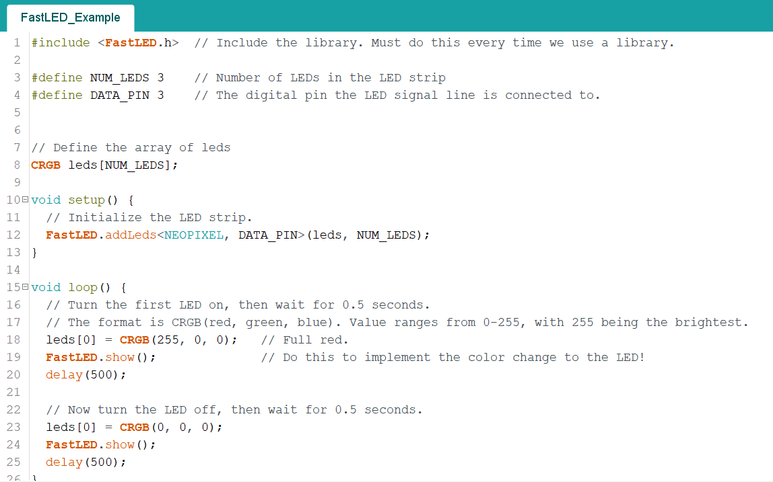
LED Strip
The code is available at
tinyurl.com/escendo2020
Objective: to control an LED strip.
Try to:
Change color and brightness.
Control all 3 LEDs.
Make a fading effect (hint: for loop and short delay).

Slide 47
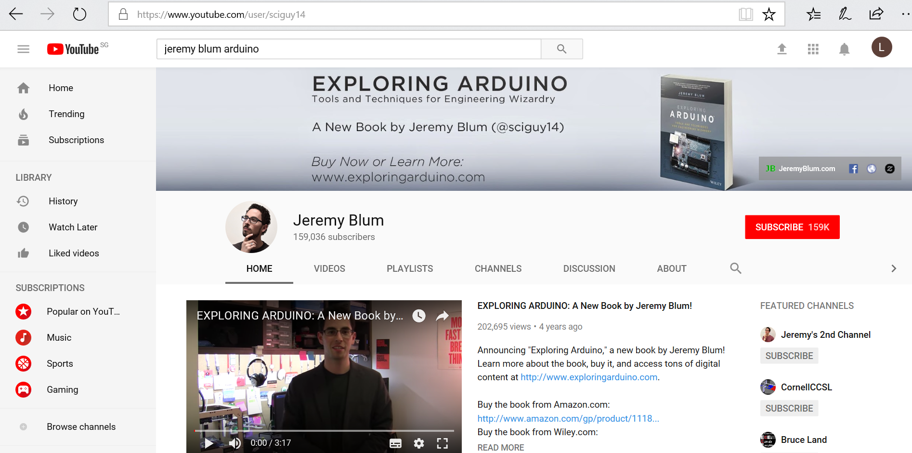
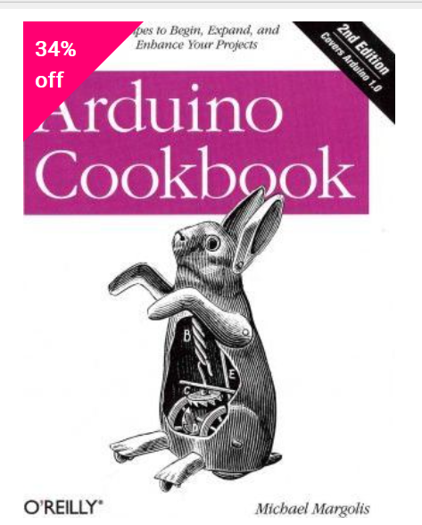
What’s next? Explore!

Slide 48
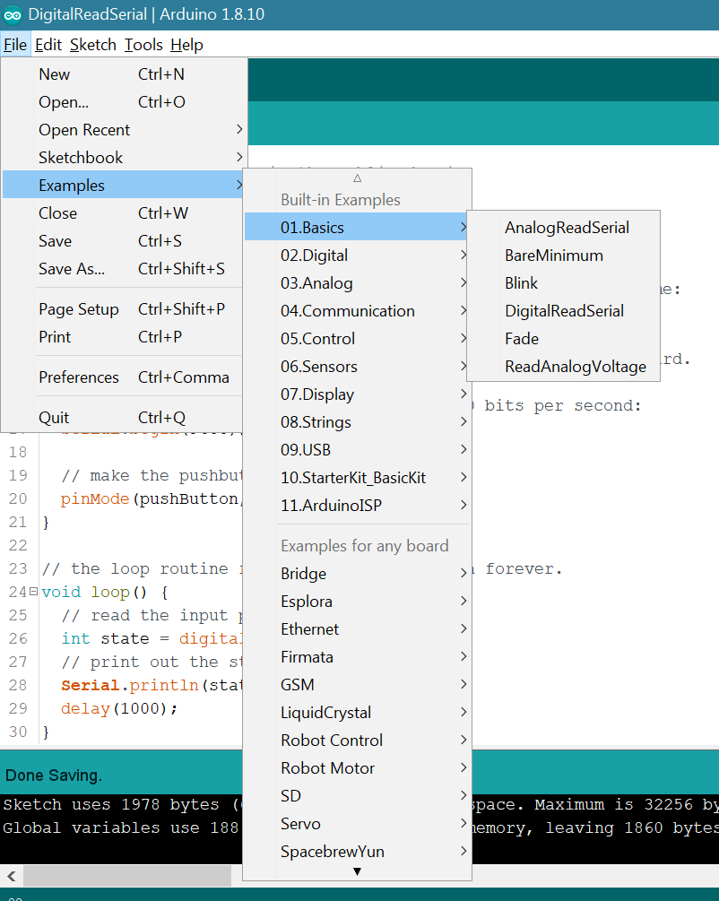
Remember, these are your best friends: - Google - Arduino Reference (arduino.cc/reference/en/) - Built-in example codes
Every time you would like to do something new / have problems, Google and online documentation can answer your questions.

Slide 49
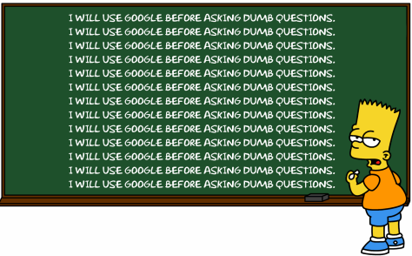
Just kidding… You’re welcome to ask us!

Slide 50
Thank You Happy Making!

